Slide 1
Introduction to query processing

Slide 2
Overview over this video
This video is meant to serve as an introduction to query processing AND also how and what a query plan is (basically, a way to look at relational algebra)

Slide 3
Where we are…
User/application
Transaction manager
Query Compiler
Responsible for
Transforming SQL queries into sequences of database operations
Executing these operations
Recovery Manager
Concurrency control/ Scheduler
Execution Engine
Buffers
Index/file/record manager
Buffer manager & storage manager
Storage

Slide 4
SQL Queries
Here typically SELECT statements
SQL query: SQL SELECT/INSERT/UPDATE/DELETE statement
Declarative: tells the DBMS what we want, not how to get it
DBMS selects a good sequence of database operations to execute the query
SELECT id AS employee_id FROM Employees WHERE department = ’Liv’;
Employees(name, id, departmnet)
Salary(e_id, month, amount)
SELECT name, sum(amount) FROM Employees, Salary WHERE id = e_id AND department = ‘Liv’
GROUP BY name;

Slide 5
How Does Query Processing Work?
SQL query
This video
Parse query & preprocess
Logical query plan (relational algebra)
Optimise logical query plan
Query optimisation (later videos)
Optimised logical query plan
Select physical query plan
Physical query plan
Query Execution

Slide 6
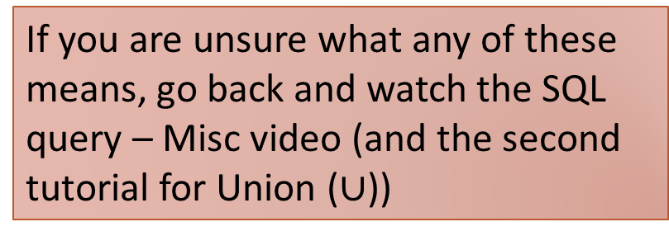
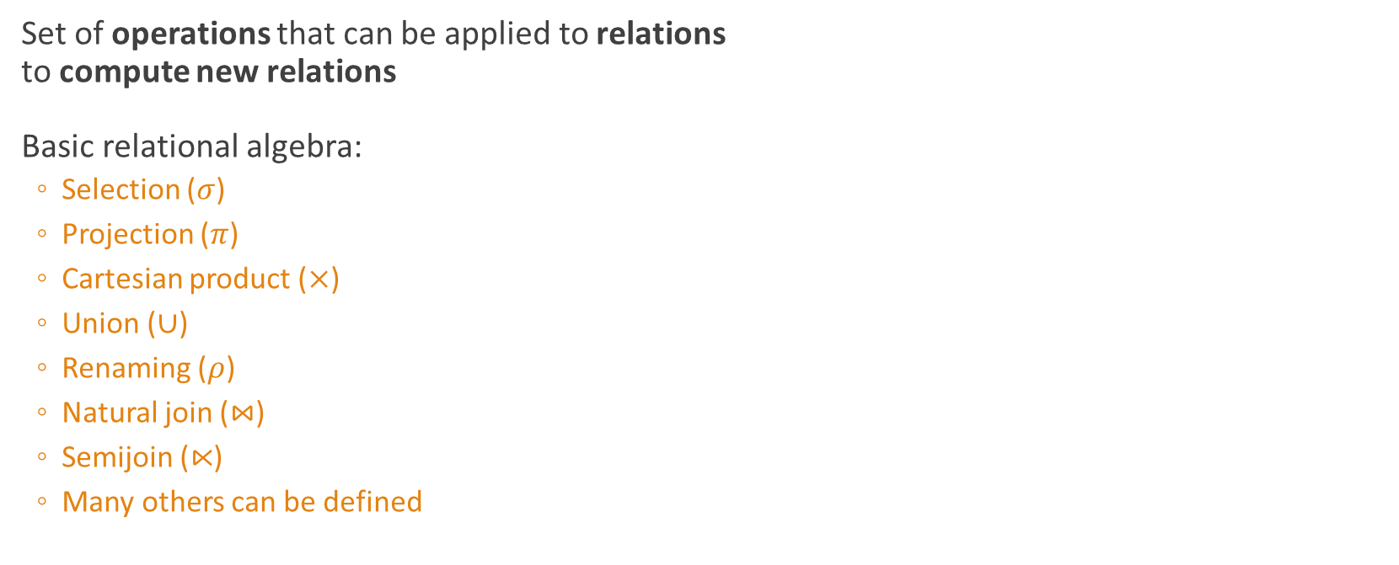
Relational Algebra
Set of operations that can be applied to relations to compute new relations
Basic relational algebra:
Selection ($σ$)
Projection ($π$)
Cartesian product ($×$)
Union ($∪$)
Renaming ($ρ$)
Natural join ($⋈$)
Semijoin ($⋉$)
Many others can be defined
R₁
operation
new relation
R₂
If you are unsure what any of these means, go back and watch the SQL query – Misc video (and the second tutorial for Union ($∪$))

Slide 7
Query Plans
A relational algebra expression that is obtained from an SQL query is also called a (logical) query plan
Query plans are typically represented as trees
SELECT department, name FROM Stores, Employees WHERE department=worksAt AND city=‘Liverpool’;
SQL query
$π$_{department,name}($σ$department=worksAt AND city=‘Liverpool’(Stores $×$ Employees))
Query plan for the query

Slide 8



Query Plans As Trees
$π$_{department,name}($σ$department=worksAt AND city=‘Liverpool’(Stores $×$ Employees))
Tree representation:
$π$ _{department,name}
Leaves = input relations
Inner nodes = operators
Such trees are evaluated from the leaves to the root
$σ$department=worksAt AND city=‘Liverpool’
$$×$$
Stores
Employees

Slide 9




Another example
Represent the following query plan as a tree:
$σ$ _{department=worksAt}($π$_{department}(Stores) $×$ $π$_{worksAt,name}(Employees))
$σ$ _{department=worksAt}
$$×$$
$π$ _{department}
$π$ _{worksAt,name}
Stores
Employees

Slide 10





Equivalent Query Plans
There are typically many different query plans
DBMSs aim to select a best possible query plan
Relational algebra is better suited than SQL for this
Can use equivalence laws of relational algebra to generate a query plan for the same query that can be executed faster!
Example:
$σ$_{condition}(R₁ $⋈$ R₂) = $σ$_{condition}(R₁) $⋈$ $σ$_{condition}(R₂)
Details will come later…
$σ$_{condition}
$$⋈$$
$$⋈$$
$σ$_{condition}
$σ$_{condition}
R₁
R₂
R₁
R₂

Slide 11
Summary
DBMS translate SQL queries into relational algebra expressions, also called (logical) query plans
The DBMS will then
Optimise the logical query plan by using equivalence laws (later…)
Select suitable algorithms for computing each operator in the logical query plan (later…)

